Slide 1
HealthConnect开发 - Ensemble Message(消息)
Notes:
11_Messages消息章节，我有一些修改建议：
1. 增加消息持久化的细节（10_EnsSystemManagement里有，可以参考那里的信息）
2. 把进程池部分的内容去掉，这需要有后面章节（业务组件部分）的知识
3. 有很多页面没有翻译
4. "queue" and "inProc"，建议放在后面章节（业务组件章节）
5. “消息的创建”有歧义，这里是指消息体的定义，不是消息创建的过程
6. “消息发送机制”里面内容基本是空的
7. 里面应该提到默认消息持久化，并提到消息可以不持久化，为后面Louis的passthrough做个铺垫

Slide 2
提纲
Message基本概念
Message的产生
Message的定义
Message的查看，trace
Message的删除
队列管理和Pool Size
同步发送还是异步发送?
Pass-through

Slide 3
业务组件与消息
BS负责接收或者扫描外部系统（推或者拉），
BO负责发送给外部的数据源、应用或系统
BP负责内部Ensemble消息的分发，路由，业务编排。。。
Router
其他组件
Ensemble消息是在业务组件间传递.
数据
数据
Ensemble
外部应用
输入型适配器
输出型适配器
外部应用
业务服务
业务流程
业务操作
Web
SOAP
Java
复合应用
数据库
Notes:
Composite Apps: 通过CSP GW与外界Apps建立与BS的直接访问
Business Operation负责将Ensemble内传递的请求发到外部的数据源、应用或系统
BO可以调用BP, with alarm, not something user would code
Messages are the communication method between components within an Ensemble application.
Messages are used between Business Services, Business Processes and Business Operations.

Slide 4
Ensemble消息基本概念
消息是Ensemble内部协调业务步骤所需要传递的数据.
消息持久化存储
术语：
消息头， 消息体
会话， SessionID
消息挂起，Suspended
消息完成，Completed
消息队列， Queue
主请求，primary request
...
Ensemble定义了两个基类，分别处理请求消息和响应消息.
Ens.Request和Ens.Response

Slide 5
消息的产生
消息在业务组件间传递时，由后台自动创建的。
执行..SendRequestAsync(“MyTarget“,myObject)的时候发生了什么
消息对象被%Save()
自动产生消息头, 消息头带有如下meta-data
source, target, Timestamped,Status, MessageBodyID
消息头被放到目标组件的Queue
FIFO
^Ens.Queue(TagetName)
唤醒(Signal)目标组件处理队列。
SendRequestAsync()返回%Status
(如果消息体的对象不是被组件发送创建，而是用户代码持久化的，那么这个消息体将没有消息头，不会被消息删除任务清除)
SourceName
DateTime
Other data
1
^Ens.Queue(TargetName)
5
TargetName
3
%Status
4
Message
2
New Header
(Ens.MessageHeader)
%Save
Notes:
Business Processes and Business Operations have queues. Business Services do not have queues since they bring in non-Ensemble messages.
Putting a message on a queue 1) saves the message and creates a message header 2) adds entry to queue – just the message header id 3) signals recipient to wake up (no polling of queue).
消息被从队列里拿出处理的方式一定是FIFO(First In First Out)
组件disable后消息仍然会放到队列， 除非停服务
消息一直存在消息队列(Queue)，直到被接收方组件处理。
队列不仅处理请求消息，还处理异步返回消息

Slide 6
消息发送机制（1）
同步调用
应该设置超时。超时后收到的响应会丢弃
method SendRequestSync(pTargetDispatchName As %String, pRequest As %Library.Persistent, ByRef pResponse As %Library.Persistent, pTimeout As %Numeric = -1, pDescription As %String = "") as %Status
(注意pTimeout的默认值为-1，意思是永久等待)
异步调用
不等待返回消息
无法设置超时
如果后面用Sync等待返回消息，收不到消息将永远等待
method SendRequestAsync(pTargetDispatchName As %String, pRequest As %Library.Persistent, pDescription As %String = "")as %Status
Notes:
Most calls from a Business Process are asynchronous calls.
For synchronous calls, a timeout setting is used. Once the timeout setting expires, any further responses to that request are discarded.
In BPL, if you forget to a sync activity for an asynchronous call, the Business Process will not wait.
In custom code, if you forget to an amount of time to wait for responses for an asynchronous call, the Business Process will wait forever.
Instead of one asynchronous call activity followed directly by a sync activity, use a synchronous call activity. Underneath the covers, synchronous calls are handled asynchronously. This will allow the actor to work on another Business Processes while waiting for the one synchronous call to return.
With more than one asynchronous call, you must use the sync activity to wait for the responses.

Slide 7
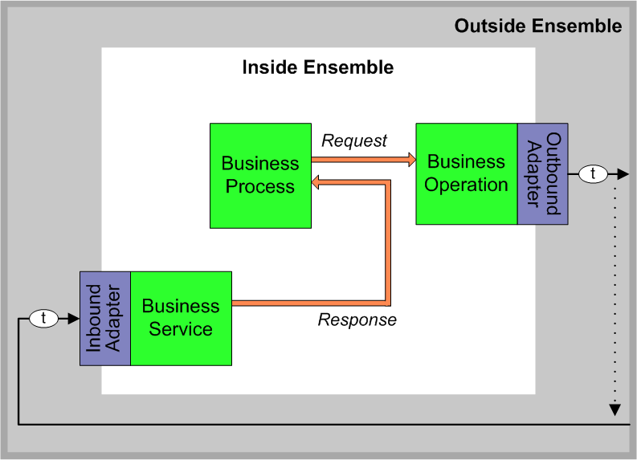
消息发送机制（2）
延迟发送(Deferred Sending)
SendDeferredResponse()为前面标示为延时的消息发送的response消息
Set sc = ..SendDeferredResponse(token, pResponseBody)
//例子: EnsLib.Workflow.Engine.cls
Notes:
Where:
token — A string that identifies the deferred response so that the caller can match it to the original request. The business service obtains the token string through some mechanism unique to the production.
For example, if the external destination is email, when sending a request for which it is willing to receive a deferred response, a business operation can include the token string in the subject line of the outgoing email. The entity receiving this email can extract this token from the request subject line and use it in the response subject line. This preserves the token so that the business service receiving the response email can use it in a subsequent call to SendDeferredResponse().
pResponseBody — A response message. This object receives the data returned by the response. See “Defining Ensemble Messages.”
This method returns a status, an instance of %Status.

Slide 8
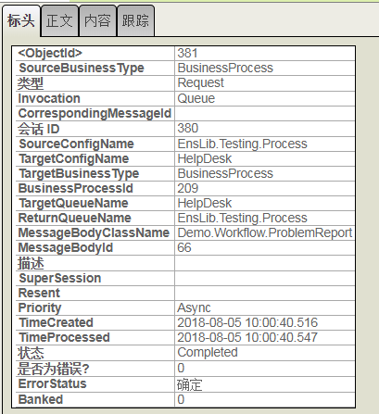
消息头
自动创建
所有消息头一样
持久化，
每个消息有消息头，对消息体可以多对一
SQL查询Ens.MessageHeader
那些字段有index?

Slide 9
Ens.MessageHeader
SELECT SessionId, id, type, SourceConfigName,TargetConfigName, IsError,Status,ErrorStatus FROM Ens.MessageHeader where sessionid=4884
SessionId ID Type SourceConfigName TargetConfigName IsError Status ErrorStatus
4884 4884 1 业务2-HL7文件接入 业务2-HL7路由 0 9 1
4884 4885 1 业务2-HL7路由 业务2-HL7文件输出 0 8 1
2 Rows(s) Affected
statement prepare time(s)/globals/lines/disk: 0.0876s/62964/372512/0ms
execute time(s)/globals/lines/disk: 0.0005s/12/1641/0ms
cached query class: %sqlcq.ENSEMBLE.cls146
---------------------------------------------------------------------------
ENSEMBLE>>

Slide 10
Ens.MessageHeader
Ens.MessageHeader是消息头的持久化储存于一个表，字段“Status”显示此消息的状态。包括以下选项：
已创建(Created)：已创建并持久化的消息，尚未进入队列
已排队(Queued)：消息进入队列
已发送 (Delivered)：接收目标已经接收了该消息,非常短暂的过度状态。
已丢弃(Discarded)：人工丢弃或者当响应消息在请求过期超时后才返回时
挂起(Suspended):
已延迟(Deferred)：BO延迟发送一个响应消息时（只针对响应消息）
已中止(Aborted):
错误(Error):
已完成(Completed)：接收目标已经接收并处理了该消息
Ensemble Message是Ensemble平台内部的消息，在类中(Ens.DataType.MessageStatus)定义了如下的状态：
DISPLAYLIST =",Created,Queued,Delivered,Discarded,Suspended,Deferred,Aborted,Error,Completed";
VALUELIST = ",1,2,3,4,5,6,7,8,9";

Slide 11
消息体
自定义消息体
继承Ens.Request, Ens.Response
继承其他的内建消息类
继承%Persistent
继承%XML.Adaptor(可选)
内建的消息类
Ens.Request, Ens.Response
Ens.StringRequest, Ens.StringResponse
Ens.StringContainer
Ens.StreamContainer
EnsLib.HTTP.GenericMessage
EnsLib.SOAP.GenericMessage
EnsLib.HL7.message
EnsLib.EDI.XML.Documnet
EnsLib.DICOM.xxxxx, and .....
Notes:
Ens.MessageBody extends %Persistent Ens.Util.MessageBodyMethods, %XML.Adaptor

Slide 12
消息体的定义-内建的消息体
Ens.MessageBody extends %Persistent, Ens.Util.MessageBodyMethods, %XML.Adaptor
Ens.Request extends Ens.MessageBody, Ens.Util.RequestBodyMethods
Ens.StringRequest, Ens.StringResponse
Ens.StringContainer extends %Persistent, %XML.Adaptor
Ens.StreamContainer extends %Persistent, Ens.Util.MessageBodyMethods, %XML.Adaptor
EnsLib.HL7.message extends %Persistent, EnsLib.EDI.BatchDocument, EnsLib.EDI.Segmented, EnsLib.HL7.Util.MsgBodyMethods
Notes:
Ens.MessageBody extends %Persistent Ens.Util.MessageBodyMethods, %XML.Adaptor

Slide 13
消息的存储
Ens.Request, Ens.Response ^Ens.MessageBodyD
Ens.StringContainer ^Ens.StringContainerD
Ens.StreamContainer ^Ens.StreamContainerD
EnsLib.HTTP.GenericMessage
EnsLib.SOAP.GenericMessage
EnsLib.HL7.message ^EnsLib.H.MessageD
EnsLib.EDI.XML.Documnet ^EnsLib.EDI.XML.DocumentD
自定义消息体 ???

Slide 14
虚拟文档的概念（ Virtual Documents ）
虚拟文档允许你把raw document作为一个整体在Ensemble的消息体里面发送，不需要将文档本身生成拥有一组属性的对象。 这样可以提高消息处理的效率。
配合系统加载的document的schema, 文档中的内容可以用类似对象的访问方式来访问。这样的访问方式在BPL，Rule, DT等工具里尤其方便。
虚拟文档的种类:
HL7 V2 messages
XML documents
X12 documents
ASTM documents
EDIFACT documents
Notes:
是一个消息
只解析消息的一部分
ENSEMBLE用来处理大的消息类型(HL7, EDI, XML...)
不创建Object
整个rawData存在global里面

Slide 15
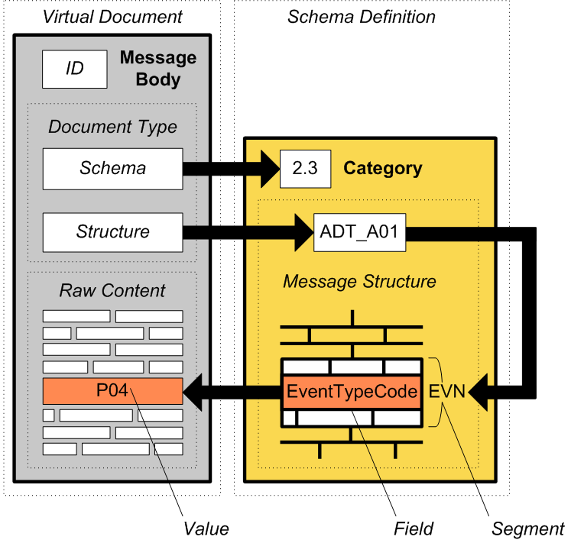
EnsLib.HL7.Message
MSH|^~\&|REGADT|MCM|IFENG||199601061253||ADT^A01|000001|P|2.3.1||||||utf-8
EVN|A01|199601061000|199601101400|1
PID|||999473857^^^GENHOSP|253763|MASSIE^JAMES^A||19560129|M|||171 ZOBERLEIN^^ISHPEMING^MI^49849^||(900)485-5344|(900)485-5344|ENGLISH|S|C|10199925|371-66-9256
PD1|||||||||
PV1||O|||||0148^ADDISON^JAMES|0148^ADDISON^JAMES|0148^ADDISON^JAMES|AMB|||||||0148^ADDISON^JAMES|S|1400|A
PV2||||||||199601101400|199601101400
DB1|||||||||||
OBX||ST|1010.1^BODY WEIGHT||62|kg
OBX||ST|1010.1^HEIGHT||190|cm

Slide 16
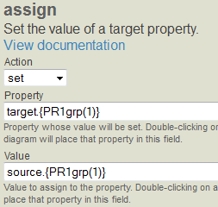
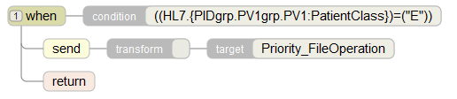
EnsLib.HL7.Message
MessageBody：EnsLib.HL7.Message
Document Type
Schema:structure: 2.3:ADT_A01

Slide 17
Ens.EDI.XML.Document
XML虚拟文档
对于复杂的XML数据，将它映射成对象处理是效率很低的方式， 通常不会这么处理。
XML数据可以使用字符串或者流的容器在Ensemble内部作为消息处理， 使用XPath寻址， 但不如使用XML虚拟文档更方便。
对于XML虚拟文档，Schema有帮助， 但不是必须的。如果有Schema, 可以做validation, 可以用schema-dependent virtual property paths (而不是DOM-Style path); DTL editor和Business Rule Editor也可以变得容易
使用virtual property path方式访问XML内容
unit1.unit2.unit3
HomeCity.Address
controlActProcess.queryByParameter.parameterList.livingSubjectId().value().extension

Slide 18
Ens.EDI.XML.Document
persistent class EnsLib.EDI.XML.Document extends %Persistent, EnsLib.EDI.XML.Prop, %XML.SAX.EntityResolver, %XML.Adaptor
DocType
RawContent
GetValueAt()
SetValueAt()
OutputToDevice(), OutputToFile(), OutputToString(), OutputToLibraryStream()

Slide 19
消息的查看
Message Viewer
什么是Search Table
Ens.MessageHeader表
有那些index
Tune-Table

Slide 20
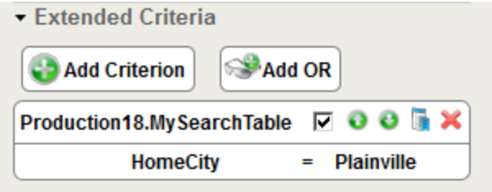
Search Table 概念
虚拟文档不能自动的按其中的virtual property path搜索。
当需要在Message Browser, 规则编辑器，以及其他的SMP页面中对虚拟文档进行搜索和过滤， 必须提供相应的Search Table。
用户使用的时候可以不用去考虑virtual property path, 可以对virtual document像对其他消息字段一样过滤和搜索。
https://docs.intersystems.com/irislatest/csp/docbook/DocBook.UI.Page.cls?KEY=EEDI_search_tables
HL7 Search Table
XML Search Table

Slide 21
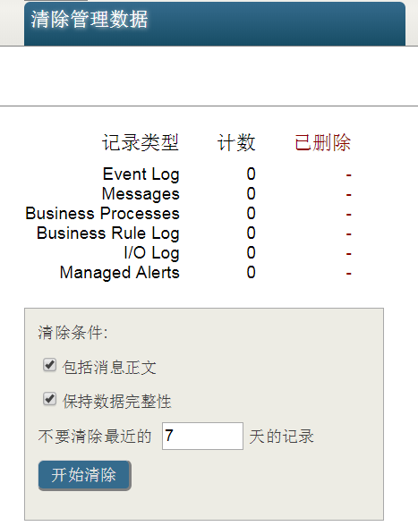
消息的删除
设置任务
管理门户>系统操作>任务管理器, 选择Ens.Util.Tasks.Purge，选择某个namespace
选择保留天数
选择包含消息正文
选择数据完整性(新版本”Purge only completed sessions“)
删除^Ens.MessageHeaderD， ^Ens.MessageBodyD
Interoperability>管理>清理管理数据，手工清除
运行命令清除
do ##Class(Ens.Util.Tasks.Purge).PurgeAll(,7,)
classmethod PurgeAll(pTypesToPurge As %String = "all", pNumberOfDaysToKeep As %Integer = 0, pBodiesToo As %Boolean = 1) as %Status

Slide 22
Purge任务的解释

Slide 23
Purge only completed sessions
如果这个被选中，只有completed消息会被删除， 也就是status=
Complete
Error
Aborted
Discarded
其他状态的消息不会被删除
时间会很长

Slide 24
消息的删除
删除消息头
删除什么消息体
消息的删除不自动删除对象属性引用的持久化（%Persistent)对象
解决的方法
Create custom purge routine.
Add delete triggers.
Add %OnDelete() callbacks.
最好的解决方案是设计中避免出现这样的情况。

Slide 25
自定义消息

Slide 26
消息体的定义-自定义消息体
继承Ens.Request (or Ens.Response)
继承%Persistent, %XML.Adapter
继承%Persistent, %JOSN.Adapter
Class reqUpdatePersonInfo Extends Ens.Request{
Property Name As %String;
Property SSN As %String;
Property DOB As %Date;
Property State As %String;
}
Notes:
以下来自learning service的ppt, 但实际测试发现Serial Class不行， 必须是Persistent,, 各种vdoc消息实际也是集成的%Persistent
Messages are often a subclass of Ens.Request or Ens.Response.
A message body can be any of the following:
Ensemble request.
Subclass of Ens.Request.
Ensemble response.
Subclass of Ens.Response.
Any persistent object.
Any serial object.
A virtual document (used with HL7 processing).
Refer to Ensemble Virtual Documents for details.

Slide 27
消息体的定义-使用%SerialObject
Class reqUpdatePersonInfo Extends Ens.Request{
Property Name As %String;
Property SSN As %String;
Property DOB As %Date;
Property Address As Address;
}
Class Address Extends %SerialObject{
Property City;
Property Street;
}
Notes:
以下来自learning service的ppt, 但实际测试发现Serial Class不行， 必须是Persistent,, 各种vdoc消息实际也是集成的%Persistent
Messages are often a subclass of Ens.Request or Ens.Response.
A message body can be any of the following:
Ensemble request.
Subclass of Ens.Request.
Ensemble response.
Subclass of Ens.Response.
Any persistent object.
Any serial object.
A virtual document (used with HL7 processing).
Refer to Ensemble Virtual Documents for details.

Slide 28
消息体的定义-使用OnDelete
如果在消息里面用到%Persistent的对象， 或者%Persistnent对象的Collection, 需要使用OnDelete来确保删除消息时也可以删除这些保留的对象。
Property p1 As Address[ OnDelete = cascade ];
Property p2 As List of Address[ OnDelete = cascade ];

Slide 29
消息体的定义-多层结构
问题: %SerailObject里面可以定义%SearilObject吗?
使用Parent-Children Relationship
/// in parent 类 Relationship Orders as FCE.CurrencyOrder[cardinality = children, Inverse = Branch]; /// in children 类 Relationship Branch as FCE.Branch [cardinality = parent, Inverse = Orders];

Slide 30
使用One-to-Many Relationship
在A,B类之间建立One-to-Many relationship。
在B类 (many侧), 修改relationship.
//在A类
Relationship Orders as FCE. CurrencyOrder [cardinality = many, Inverse = Branch]; /// in many 类 Relationship Branch as FCE.Branch [Cardinality = one, Inverse = Orders, Required, OnDelete = cascade] Index BranchIndex on Branch;
结果：
B类ID的是整数，所有可以用bitmap索引.
参数Required保证B类的索引对象有到A类对象的引用
参数cascade保证删除A类对象也删除B类的对象

Slide 31
练习1
创建消息Test.Patient继承Ens.StringRequest
包括字段name, DOB, address(serialobject),NationalID,
Save并且确认存储

Slide 32
练习2
构建消息类传递如下XML结构

Slide 33
创建非持久化消息的Pass-Through服务
为了提高效率,可以由BS以InProc的方式直接调用BO,
没有持久化消息， 无法做排错
无法重发，如果发送失败，错误消息直接返回外部客户端
只在path-through的BS和BO间起作用， 中间不能有其他的BP， BO组件，否则还是会出现持久化的消息。
添加下面操作类
EnsLib.HTTP.GenericOperationInProc
EnsLib.REST.GenericOperationInProc
EnsLib.SOAP.GenericOperationInProc
Notes:
If the pass-through service is using the standard Web port, you can further improve efficiency by configuring the service to keep the TCP connection open between calls. To do this, in the pass-through service configuration, check the Keep Standard Request Partition check box.

Slide 34
预置的Pass-through业务组件(1)
Business Service：
EnsLib.HTTP.GenericService
EnsLib.REST.GenericService
EnsLib.REST.SAMLGenericService
EnsLib.SOAP.GenericService
EnsLib.SOAP.SAMLGenericService
Business Operation
EnsLib.HTTP.GenericOperation
EnsLib.HTTP.GenericOperationInProc
EnsLib.REST. GenericOperation
EnsLib.REST. GenericOperationInProc
EnsLib.SOAP. GenericOperation
EnsLib.SOAP. GenericOperationInProc

Slide 35
Message Bank

Slide 36
Enterprise Tools (v2010.1+)
在一个界面(Portal)管理多个产品
Enterprise Monitor page.
监控多个产品的状态
Enterprise Message Viewer. (v2013.1+)
允许查看和搜索多个产品的消息
访问各产品中的原始消息
Message Bank Viewer.
允许查看，搜索和重发 Enterprise Message Bank中的消息
Enterprise Message Bank contains copies of original messages.
Message Bank Event Log.
允许查看，搜索Event Log entries in Enterprise Message Bank.

Slide 37
Enterprise Message Bank (v2010.1+)
Live Production
Enterprise Message Bank Production
Message
Bank
Business
Operation
Messages
and
Event Log
items
Message
Bank
Business
Service
Message
and
Event Log
repository
Live Production
Message
Bank
Business
Operation
Monitor
Business
Service
Status
repository
Notes:
The Enterprise Message Bank is a separate Production usually installed on a machine not running any live Productions.
To send messages and Event Log entries to the Enterprise Message Bank, the client Productions only requires the Message Bank Business Operation be added and configured.
Messages and Event Log entries are automatically sent to the Enterprise Message Bank. The messages and Event Log entries are not removed from the client system.

Slide 38
Enterprise Message Viewer (v2013.1+)
 | Enterprise Message Viewer | Enterprise Message Bank
Source of Message | Original message in client namespace. | Copy of original message stored locally in Enterprise namespace.
Resend Message | Not possible. | Possible.
View Message | Displays basic information about message. | Shows complete message.
Access Message | Follow link to open Message Viewer in client namespace. | Shows complete message.
Client Production | Need not modify client Production to access messages. | Add Business Operation to client Production.

Slide 39
消息优先级
消息引擎自动决定消息的优先级：
高同步HighSync (1) — 用于ACK消息和警告.
同步Sync (2) — 用于需要比普通同步消息更高优先级的同步消息.
普通Normal (3) — 用于大多数同步消息.
半同步SimSync (4) — 用于由BPL 同步 <call>产生的异步调用. 这确保请求和响应消息在排队的一步消息前被处理.
异步Async (6) —用于异步消息.
消息优先级无法人工修改
Notes:
http://localhost:57773/csp/docbook/DocBook.UI.Page.cls?KEY=EMONITOR_concepts#EMONITOR_concepts_msg_priority

Slide 40
Thank you

